Slide 1
FOR THE HEALTH OF IT
café LA & LAUSD WELLNESS PROGRAMS DEPARTMENT

Slide 2
EMPLOYEE WELLNESS
Café LA, LAUSD Wellness Programs Department and Alliance For A Healthier Generation have partnered up to bring division staff monthly newsletters that are centered around employee wellness.
The goal is to ensure the coordination of health and wellness services throughout the District.

Slide 3
WHY EMPLOYEE WELLNESS?
LAUSD recognizes the critical relationship between a healthy student and academic achievement.
Students must be healthy to be educated and be educated to be healthy.
We are committed to providing an environment where students can learn to make healthy choices for lifelong health.

Slide 4
WHAT IS THE BLUEPRINT FOR WELLNESS?
The Blueprint for Wellness Policy is the District’s wellness policy and guide for implementing a comprehensive health and wellness plan and serves to further advance wellness throughout the District for:
Students
Parents
Staff
Community

Slide 5
8 COMPONENTS OF THE BLUEPRINT FOR WELLNESS
Nutrition Services
Physical Education
Health Education
Health Services
Positive Attendance & Building Resiliency
Safe Environment
Staff Wellness
Parent & Community Involvement

Slide 6
Nutrition Services | Physical Education | Health Education | Health Services
The Food Services Division, Café LA, offers healthy choices to fuel students learning and education. | A strong correlation exists between physical fitness and academic achievement. | Some students have preventable health-related issues that make it difficult for them to achieve academically in a classroom structure. | Healthy school communities help to improve student attendance, foster a cohesive school culture, and improves student achievement.
Positive Attendance & Building Resiliency | Safe Environment | Staff Wellness | Parent & Community Involvement
School staff can create environments that motivate students to come to school every day and provide opportunities to build resiliency. | Students and staff have the right to an environment that is safe, and free from disruption and obstacles that impede learning and teaching. | In order to promote student wellness, employee wellness must also be emphasized. | Parent involvement directly affects a child’s health and academic success.

Slide 7
CAFÉ LA GOOD NUTRITION
Café LA is committed to offering food that is of quality products. The food items served in our cafeterias have no:
NO nitrates, sulfites, or artificial colors or sweeteners.
The chicken we serve is raised with
No Antibiotics Ever
The food we serve has no added trans fat.
All food served is whole grain rich.
Breakfast we provide is low in sodium.

Slide 8
Quality of a Diet
The quality in the food we provide helps to support children and their families who otherwise might not have access to nutritious meals.
Low in fat, sodium, and sugar, but high in fiber.
Variety from all food groups.
Portion sizes are age appropriate and do not provide excess calories.
Many of our students face food insecurity and live in a food desert where people have limited access to healthful and affordable food, due to having low income or having to travel farther to find healthful food options.
Notes:
Put in same text box

Slide 9
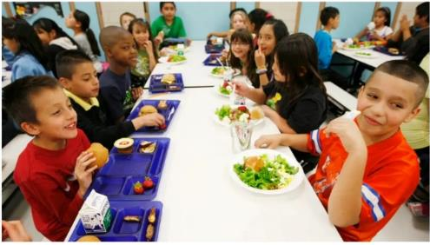
School Meal Programs
Food Services Division operates the largest School Breakfast Program and second largest National School Lunch Program in the United States, servicing:
695 cafeterias
89 Early Ed Centers
100+ offsite programs each day

Slide 10
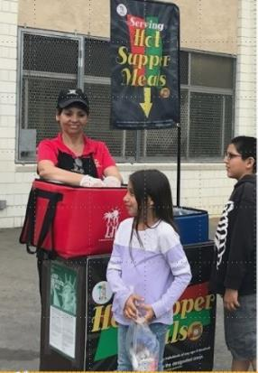
School Meal Programs
USDA research shows that children who participate in the school lunch program have superior nutritional intake compared to those who do not. This intake helps to improve students’ wellness.

Slide 11
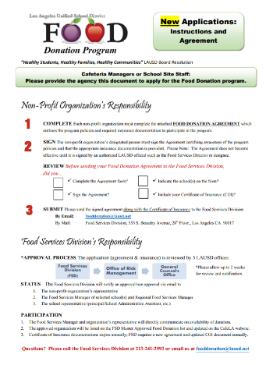
Food Waste Prevention Food Donation Program
The “Healthy Students, Healthy Families, and Healthy Communities Resolution” allows the District to donate excess food from the school meal program to approved non-profit organizations.

Slide 12
Food Waste Prevention Save it for Later Program
USDA allows students to take certain foods items outside the foodservice area to consume later in the day.
The “Save It For Later” poster is placed in every classroom to encourage children to save food, rather than waste it.

Slide 13
Safe Food/Safe Environment
LAUSD is committed to providing schools with climates that focus on safety, teaching, learning, and interpersonal relationships that enhance student academic achievement and well-being.

Slide 14
Safe Food/Safe Environment
Food Services Division contributes to a safe environment for students by serving safe food. Safe food is the foundation to providing quality food service to our students. Here are some of the ways we ensure our food is safe:
Every cafeteria has at least one person that is ServSafe certified
Monthly safety trainings for all staff
District uses a HACCP system in all schools, NNC, and warehouse
Access is limited to authorized personnel
Sanitization & safety inspections conducted

Slide 15
Physical Education
A strong correlation exists between physical fitness, quality nutrition and academic achievement. Physical Education is a required school curriculum and is the only subject with a mandated number of minutes.
The high-quality food we provide serves as fuel for children to exercise.

Slide 16
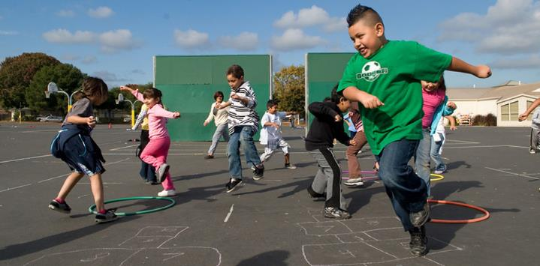
Physical Education
Students accumulate up to 40% of their daily physical activity during recess.

Slide 17
Physical Education
LAUSD has an entire page on our website with short physical fitness videos to help students, faculty and staff get moving.
These videos are available for you as well!

Slide 18
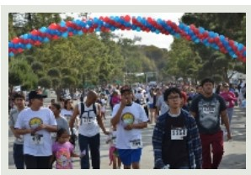
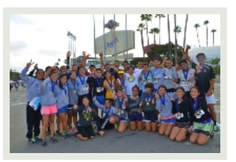
LAUSD 5K “Move It!” Challenge and Wellness Festival
A District-wide fun and engaging event that promotes wellness while giving students, parents, staff, and community members an opportunity to Move It!
This event promotes the benefits of active living and healthy eating while raising important dollars for the Blueprint for Wellness Policy and LAUSD Wellness Centers.

Slide 19
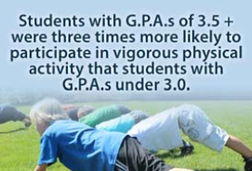
Health Education
It is important that we promote healthy lifestyles and decision making to our students.
There are some startling statistics of our youth in America.

Slide 20
Health Services
Supports the school community by offering students health services such as; Student and Family Wellness Hotline, Wellness Centers, medical, dental and vision services and much more.

Slide 21
Providing Health Services
LAUSD has an extensive history of providing health services to students and the larger school community. The delivery of health services (including medical, dental, vision, and mental health) is an important concern, particularly when students do not have access to basic, quality health care.
Disease prevention & early detection services offered:
Immunization Requirements
1st Grade CHDP Examination Requirement
Oral Health Assessment
Pre-Participation Physical Examination for Athletics
Condom Availability

Slide 22
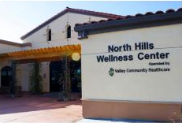
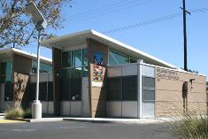
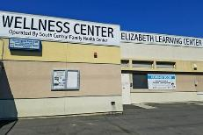
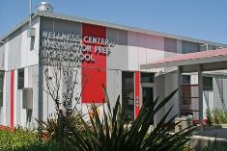
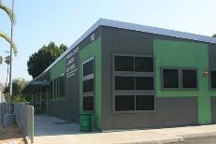
District Wellness Centers
Local District | School / Wellness Center
North South | James Monroe High Maclay Middle School (coming soon) Carson High School Fremont High School Jordan High School Locke Early Education Center
East | Elizabeth Learning Center Gage Middle School Garfield High School Maywood Center for Enriched Studies
West | Crenshaw High School Hollywood High School Washington Prep Wellness Center
Central | Belmont High School Jefferson High School Manual Arts High School

Slide 23
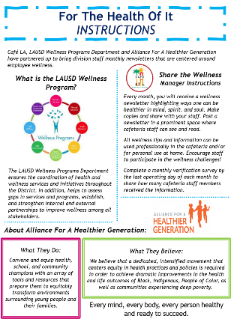
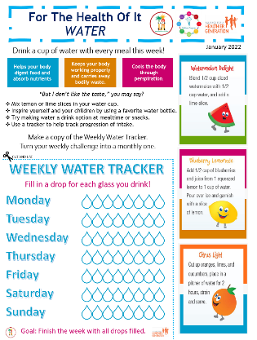
Monthly Newsletters
Each month a newsletter is posted on the food service website highlighting ways one can be healthier in mind, spirit and soul.
Post newsletter in a prominent space where cafeteria staff can see and read
Wellness tips can be used professionally at work and personal life
Complete monthly verification survey by last operating day of each month

Slide 24
Be A Wellness Warrior
Be the spokesperson for your site to get your team involved in monthly wellness. Lead your team by engaging in healthy activities.
Take time to discuss newsletter collectively as a group
Start a club to encourage wellness activity
Fight sickness with wellness!

Slide 25
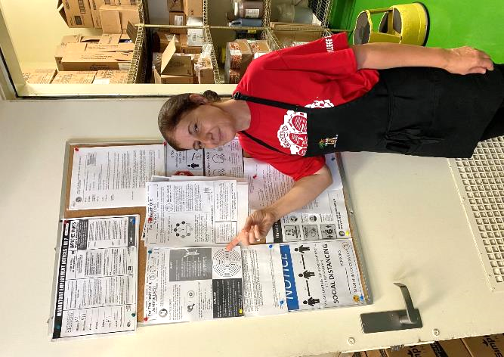
Newsletter Posting
Posting the newsletter serves as a reminder to practice the wellness activities. Post in a highly visible area with lots of exposure. Every time you and your staff pass by, you will be reminded with helpful tips. Places to post include:
Cafeteria office door
Employee locker room
Near handwashing sink
Mari
Hazeltine El.

Slide 26
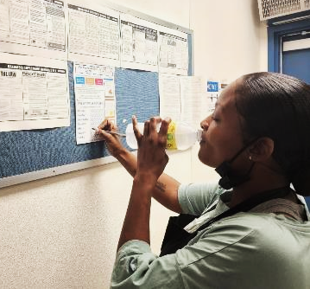
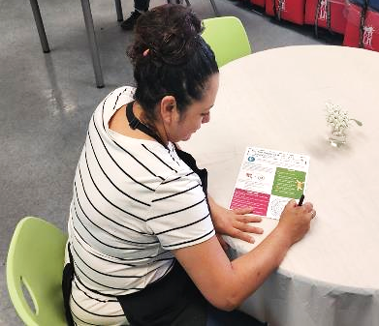
Team Involvement
Print out multiple copies of the newsletter for your team. They can complete activities individually and keep track of their progress on their own.
Maryann, Edwigis and Alma at Elizabeth Learning Center

Slide 27
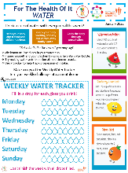
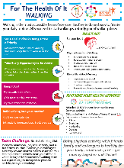
Newsletters Recap
Take a look at the past years wellness topics.
Which ones were your favorites?
GRATITUDE
December 2021
BREATHING
February 2022
WATER
January 2022
WALKING
March 2022

Slide 28
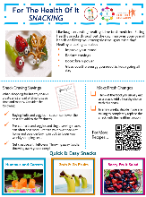
Newsletters Recap
Previous newsletters are available on food service website.
SNACKING
April 2022
COOL FOR SUMMER
June 2022
MINDFULLNESS
May 2022

Slide 29
Wellness Feedback
Is there a topic you would like to see on the monthly Wellness Newsletter?
If so, please contact Selina.Gordian@lausd.net with a recommendation of your own.
We also appreciate the stories of how you and your team are implementing wellness at your site. Email Selina with your wellness story.

Slide 30
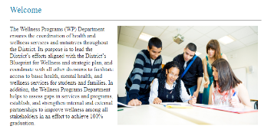
Wellness Programs Website
Visit the Wellness Programs home page for other great resources.
www.achieve.lausd.net/wellnessprograms
Find a variety of exercise videos on the Health and Wellness Fitness Channel.
Crisis Counseling and Intervention Services for students and staff
Mindfulness for staff with help from the Headspace App on your phone

